Slide 1
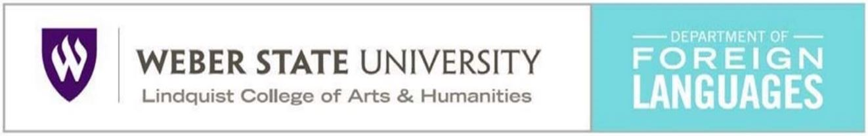

THE END OF PROFICIENCY
Will History Repeat Itself?
Tom Mathews
Professor of Spanish
February 14, 2018
Ogden, UT

Slide 2
A QUICK SURVEY
by raise of hands. . .
When did you take an FL teaching methods course?
Before 1985
1985-2000
2000-2020
What is the “goal” of your FL classroom?
Fluency and accuracy
Communicative competence
Proficiency
What is the most common ‘activity’ your students due during class?
Listening to the language
Doing exercises with

Slide 3
Two history lessons. . .
One personal,
the other global.

Slide 4
History lesson No. 1
Tom Mathews
Professor of Spanish
Weber State University
I grew up in Los Angeles California. Studied Spanish from 3rd through 11th grade.
I didn’t learn much. Was ‘asked’ to drop AP Spanish my senior year.

Slide 5
History lesson No. 1
Tom Mathews
Professor of Spanish
Weber State University
I grew up in Los Angeles California. Studied Spanish from 3rd through 11th grade.
LDS Mission in Spanish (1975-1977).
I learned fast and pretty well. I did not study grammar.

Slide 6
History lesson No. 1
Tom Mathews
Professor of Spanish
Weber State University
I grew up in Los Angeles California. Studied Spanish from 3rd through 11th grade.
LDS Mission in Spanish (1975-1977).
BA (1981). Spanish Teaching. Weber State College.
Trained in the Oral/Aural Method. Better known as the Audio-Lingual Method.

Slide 7
History lesson No. 1
Tom Mathews
Professor of Spanish
Weber State University
I grew up in Los Angeles California. Studies Spanish from 3rd through 11th grade.
LDS Mission in Spanish (1975-1977).
BA (1981). Spanish Teaching. Weber State College.
Spanish Teacher at Wahlquist JHS in Weber County.
Aaargh!

Slide 8
History lesson No. 1
Tom Mathews
Professor of Spanish
Weber State University
I grew up in Los Angeles California. Studies Spanish from 3rd through 11th grade.
LDS Mission in Spanish (1975-1977).
BA (1981). Spanish Teaching. Weber State College.
Spanish Teacher at Wahlquist JHS.
MA in Spanish Lit & PHD in Linguistics
Began to think seriously about pedagogy and methodology.

Slide 9
History lesson No. 1
Tom Mathews
Professor of Spanish
Weber State University
I grew up in Los Angeles California. Studies Spanish from 3rd through 11th grade.
LDS Mission in Spanish (1975-1977).
BA (1981). Spanish Teaching. Weber State College.
Spanish Teacher at Wahlquist JHS.
MA in Spanish Lit & PHD in Linguistics
Teaching at WSU since 1996.
Now I have the old age and hind sight to see how things have changed.

Slide 10
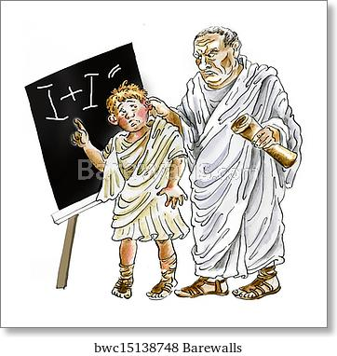

History lesson No. 2
A BRIEF HISTORY OF WORLD LANGUAGE TEACHING

Slide 11
Overview
Historical Movements in language teaching in Western Europe & the United States
Grammar Translation
Natural Methods
The Audiolingual Method
Communicative Competence
The Age of Methods
The Proficiency Movement
The National Standards

Slide 12
Overview
Historical Movements in language teaching in Western Europe & the United States
Grammar Translation
Natural Methods
The Audiolingual Method
Communicative Competence
The Age of Methods
The Proficiency Movement
The National Standards
antiquity. . .
1880s . . .
1940s. . .
1960s. . .
1970s. . .
1980s. . .
1990s. . .

Slide 13
St. Augustine of Hippo
(354-430 AD)
I learned to speak. It was not that my elders taught me words in any set method; when they named a thing I saw and remembered what they would point out by the name they uttered. And that they meant this thing and no other was plain from the motion of their body.
“The Confessions”

Slide 14
In ancient times there were basically two reasons for which a person would want or need to learn a second language.
The language of a dominant empire was often necessary to improve a person’s economic or political aspirations.
Extinct or nearly extinct languages are often learned for liturgical (religious) reasons.

Slide 15
Economic or Political Reasons
In the Roman Empire educated Romans (native-speakers of Latin) learned Greek in school. Their interest was not in “conversational” Greek, but in the ability to read classic Greek texts.
Other residents of the Empire often needed to learn Latin (in the West) or Greek (in the East) since local languages were generally not written nor used in politics, business, or literature.

Slide 16
Liturgical Languages
Although Latin became extinct as a spoken language in the fifth century AD, it continues to be used by the Roman Catholic Church.
Until the 1970s only Latin was approved for use in the Mass and other liturgical rituals. Catholic priests are still expected to master reading, and to a lesser extent, writing, in Latin.

Slide 17
Liturgical Languages
Hebrew went extinct about 500 BC. From then on, until only recently, Jewish boys learned to read and understand only enough Hebrew to read and understand the scriptures and to participate in religious rituals and prayers.
Even today, young Jews often attend “Hebrew School” at their local synagogue.
Hebrew was ‘revived’ in the late 1800s as part of the Zionist movement; it is the national language of the State of Israel.

Slide 18
Grammar School
Through the Middle Ages, before a real education could begin, students needed to first learn Latin and perhaps also Greek.
Most University classes in Europe were conducted in Latin until modern times.

Slide 19
THE
GRAMMAR-TRANSLATION
METHOD
From ancient times through until the late 1800s, with very few exceptions, the purpose for teaching languages was to get students to read and write in them.
Conversational skills were NOT the goal.

Slide 20
The Renaissance
Three notable language teachers from the Renaissance broke with the grammar/translation tradition:
Guarino da Verona (1374-1460)
Antonio de Nebrija (1441-1522)
Johann Amos Comenius (1592-1670)
I none of these cases did any lasting changes take place.

Slide 21
Guarino da Verona
Italy (1374-1460)
Guarino da Verona as an early Italian humanist celebrated for his scholarship and reputation as a teacher.
He argued that students must acquire “the habit of speaking continually in Latin” in addition to the ability to read and write.

Slide 22
Guarino da Verona
Italy
Guarino argued that if students were going to be able to use Latin to understand classical texts, as well as to convey new ideas, Latin must be acquired as a living, practical language. He proposed that the first emphasis should be on meaning, rather than on form.

Slide 23
Antonio de Nebrija
Spain (1441-1522)
An important member of the Court of Fernando and Isabel, los Reyes Católicos, Nebrija designed the “Spanish” flag, coined the national motto. He wrote several treatises on law, on history, on Latin, and most famously, published the “Gramática de la lengua castellana” in 1492.

Slide 24
Gramática de la lengua castellana
In 1492, Nebrija published the first grammar book in Europe the purpose of which was to describe a living language (as opposed to dead languages like Latin, Greek or Hebrew).
As a language-learning text it was unsuccessful, but as a scholarly description of a language it was, and still is, tremendously interesting.

Slide 25
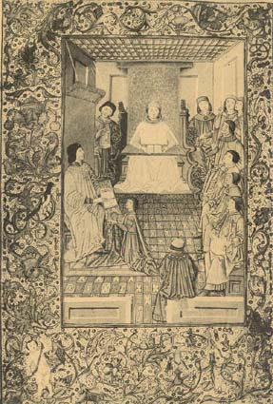
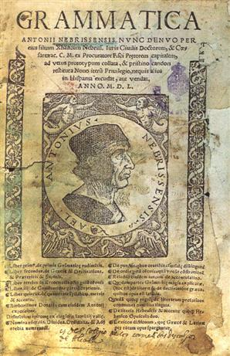
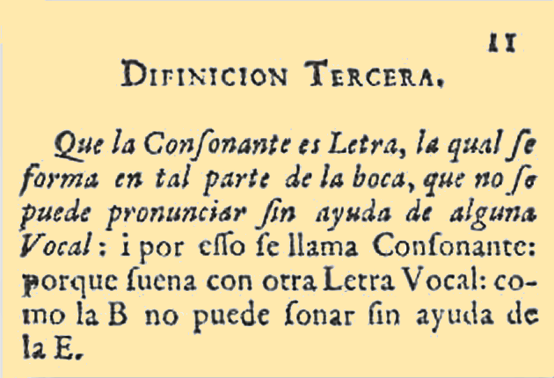

Slide 26
Jan Amós Komenský
Czech (1592-1670)
Referred to in English as Johann Amos Comenius, he developed curricula for infancy through the university and proposed a universal system of education.
He advocated the use of widely used common languages to replace Latin, which was by this time only used for Church, law and scholarly pursuits.

Slide 27
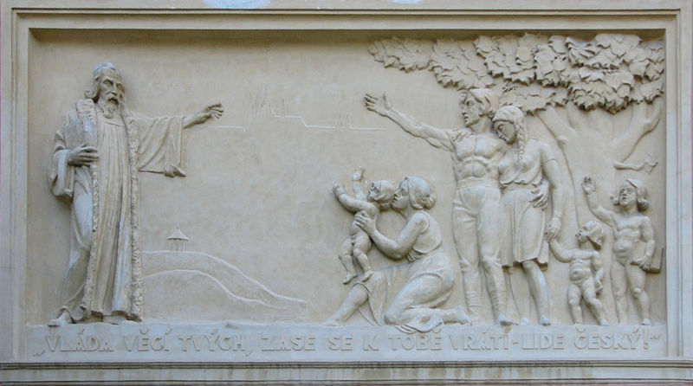
Jan Amós Komenský
Czech
Comenius was quite famous in his own time, not for his philosophical treatises, but for his very popular textbooks for teaching Latin.
Sculpture of Comenius on a school building in Dolany, Czech Republic.

Slide 28
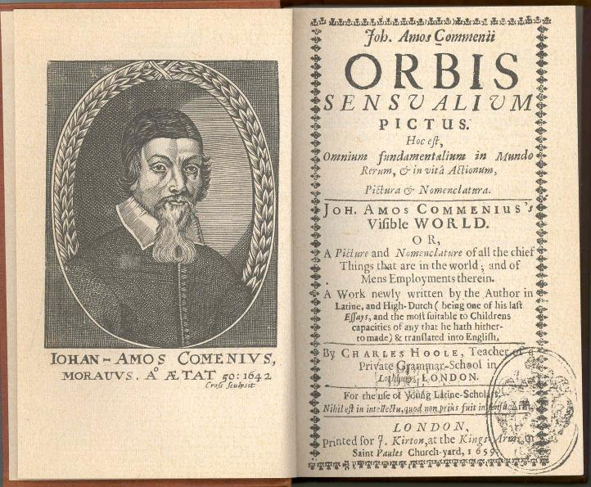

Slide 29
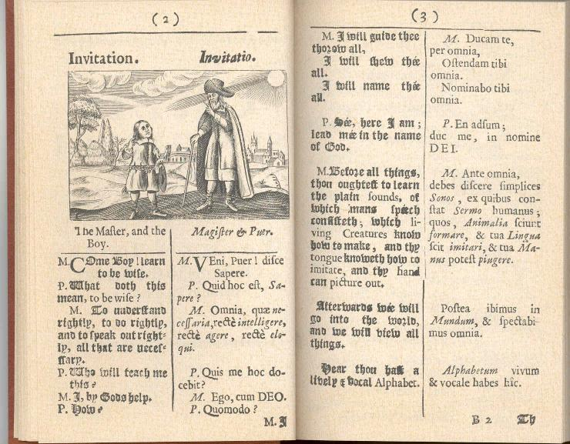

Slide 30
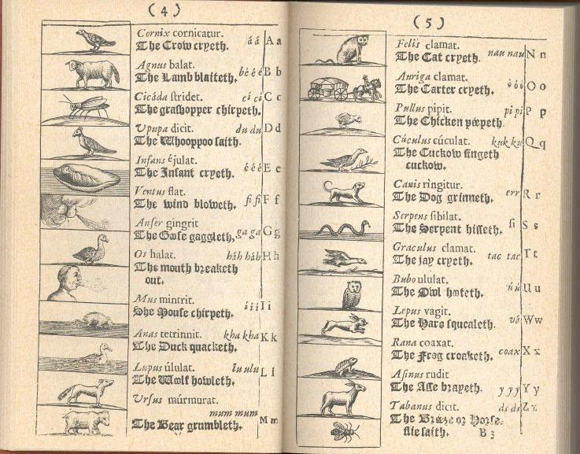

Slide 31
THE
REFORM MOVEMENT
In the late 1800s several educators rejected the Grammar-Translation Method in the teaching of living languages. This gave to two notable “methods” in foreign language teaching:
The Natural Method
The Direct Method
The Reform movement centered on the idea that “learning” a language (either L1 or L2) is not the same as most other kinds of learning; i.e., grammatical explanations and memorization do not result in fluency.

Slide 32
The Natural Method
Working independently,
Thomas Pendergast (England)
and
François Gouin (France)
based their methods on watching how children learned language and on their own frustrating experiences with Grammar-Translation.

Slide 33
François Gouin
“The Art of Learning and Studying Foreign Languages” (1880)
Gouin described his “harrowing” experiences of learning German, which helped him gain insights into the intricacies of language teaching and learning. Living in Hamburg of one year, he attempted to master the German language by dint of memorizing a German grammar book and a list of 248 irregular German verbs, instead of conversing with the natives. Exulting in the security that the grounding in German grammar offered him, he hastened to go to the University to test his knowledge. To no avail. He could not understand a word! After this failure, he decided to memorize the German roots, but with no success. He went so far as to memorize books, to translate Goethe and Schiller, and to learn by heart 30,000 words in a dictionary, only to meet with failure. Upon returning to France, Gouin discovered that his three-year-old nephew had managed to become a chatterbox of French—a fact that made him think that the child held the secret to learning a language.
(from Brown, 1973)

Slide 34
The Direct Method
The Direct Method was developed by Maximilian Berlitz, born in Germany, but as an adult he moved to France and then the United States.
He popularized the idea of teaching directly in the target the target language and in a natural way (i.e., no “foreigner-talk” or “motherese”, etc.).
He founded the Berlitz Language Schools in 1878 in Providence, Rhode Island.

Slide 35
The Direct Method
Rules followed at the Berlitz Language Schools:
Never translate: demonstrate
Never explain: act
Never make a speech: ask questions
Never imitate mistakes: correct
Never speak with single words: use sentences
Never speak too much: make your students speak
Never go too fast: keep pace with the students
Never speak too slowly
Never speak too quickly
Never speak too loudly
Never be impatient: take it easy
(from Titone, 1968)

Slide 36
THE
REFORM MOVEMENT
Influence for reform took decades to permeate into foreign language education, but slowly emphasis in high school and college classes moved from the Grammar-Translation Method to more practical and “conversational” methods.

Slide 37

Summary. . .
So, we’ve seen a pendulum swing back and forth a couple of times—from pedantic grammar-based instruction, to communicative interaction-based classrooms.
Grammar-
Translation

Slide 38
Summary. . .
So, we’ve seen a pendulum swing back and forth a couple of times—from pedantic grammar-based instruction, to communicative interaction-based classrooms.
Grammar-
Translation
Guarino de Verona
& Comenius

Slide 39
Summary. . .
So, we’ve seen a pendulum swing back and forth a couple of times—from pedantic grammar-based instruction, to communicative interaction-based classrooms.
Grammar-
Translation
Guarino de Verona
& Comenius
More Grammar-
Translation

Slide 40
Summary. . .
So, we’ve seen a pendulum swing back and forth a couple of times—from pedantic grammar-based instruction, to communicative interaction-based classrooms.
Grammar-
Translation
Guarino de Verona
& Comenius
More Grammar-
Translation
Natural
Approaches

Slide 41
THE
COLEMAN REPORT
Coleman, Algernon. 1929. The Teaching of Modern Foreign Languages in the United States. Publications of the American and Canadian Committees on Modern Languages. New York: Macmillan.
This influential publication, the result of a six year study, concluded that there simply is not enough time in high school or college classes to teach conversation skills in a foreign language, and that emphasis should be placed exclusively on teaching reading. It also cited limited skills of language teachers and the irrelevance of foreign language to the college curriculum.

Slide 42
Through this period foreign language education was not particularly successful in the United States or in Europe.
Adolf Hitler commented on foreign language education in “Mein Kampf” the book he wrote mostly in prison.

Slide 43
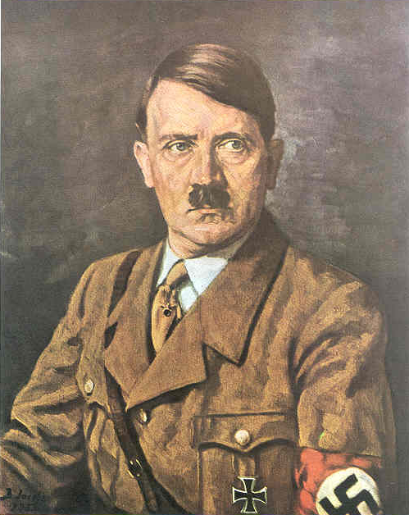
It is impossible to understand, for example, why millions of people in the course of the years must learn two or three foreign languages only a fraction of which they can make use of later and hence most of them forget entirely, for of a hundred thousand pupils who learn French for example, barely two thousand will have a serious use for this knowledge later, while ninety-eight thousand in the whole further course of their life will not find themselves in a position to make practical use of what they had once learned. They have in their youth, therefore, devoted thousands of hours to a subject
which later is without value and meaning for them. And the objection that this material belongs to general education, is unsound, since it could only be upheld if people retained all through their life what they had learned. So in reality, because of the two thousand people for whom the knowledge of this language is profitable, ninety-eight thousand must be tormented for nothing and made to sacrifice valuable time.
And in this case we are dealing with a language of which it cannot even be said that it implies a training in sharp, logical thinking as applies, for example, to Latin.
Mein Kampf

Slide 44
The Audiolingual Method (ALM)
After World War II, three phenomena coincided to result in a resurgence of foreign language education and the creation of a completely new way of teaching languages.
In psychology, Behaviorism had become an all explaining theory of learning in the US and Europe.
The Cold War left the US with a need for fluent and educated SPEAKERS of a large number of foreign languages.
Tape recorders were now inexpensive enough that most schools could afford a “language laboratory.”

Slide 45
Behaviorism
The behaviorist explanation is that language is learned like any and every other human behavior. If conditioned with proper stimulus and reinforcement, any person can learn any language.
In 1957, B. F. Skinner published “Verbal Behavior,” 478 pages on language learning as explained by behaviorism.

Slide 46
Nelson Brooks, in his 1964 text “Language and Language Learning,” supports a behaviorist view of language:
Learning may be defined as a change in performance that occurs under the conditions of practice. (p. 46)
Language is a highly complicated activity, and it is wholly learned.... The single paramount fact about language learning is that it concerns, not problem solving, but the formation and performance of habits. The learner who has been made to see only how language works has not learned any language; on the contrary, he has learned something he will have to forget before he can make any progress in that area of language. (pp. 48-49)

Slide 47
The Death of Audiolingualism
In 1959, Noam Chomsky, linguist and Harvard professor, wrote a 32-page book review of B.F. Skinner’s final.
The Audiolingual Method fell out of favor, partly because of its faulty theoretical underpinning, but mostly because it simply doesn’t work.
The complete emphasis on memorization and repetition coupled with a fear of error does not produce speakers who cannot carry on unplanned conversations.

Slide 48
Communicative Competence
The Proficiency Movement and Standards
Since the 1960s, the profession and practice of world language teaching has moved toward:
speaking ability in real life situations
competence for professional settings
cultural and linguistic understanding

Slide 49
Communicative Competence
The Proficiency Movement and Standards
EVIDENCE OF PROGRESS
TOWARD REAL LANGUAGE USE
Dual Language Immersion has become ever more common.
Students in many states are being acknowledged with the Seal of Biliteracy.
Universities have been offering “language for the professions.”
Teachers are required to be at the Advanced Low level or better.
Since the 1970s, UFLA has grown from a gathering of 50 or so teachers, to a conference of nearly 500 each year!
Since the 1960s, the profession and practice of world language teaching has moved toward:
speaking ability in real life situations
competence for professional settings
cultural and linguistic understanding

Slide 50
Can we learn from history?
Are there any signs that the pendulum will swing back again?
Grammar-
Translation
Guarino de Verona
& Comenius
More Grammar-
Translation
Natural
Approaches
The Coleman
Report & ALM

Slide 51
Can we learn from history?
Are there any signs that the pendulum will swing back again?
Grammar-
Translation
Guarino de Verona
& Comenius
More Grammar-
Translation
Natural
Approaches
The Coleman
Report & ALM
The Proficiency
Movement

Slide 52
Can we learn from history?
Are there any signs that the pendulum will swing back again?
Grammar-
Translation
Guarino de Verona
& Comenius
More Grammar-
Translation
Natural
Approaches
The Coleman
Report & ALM
The Proficiency
Movement
THE FUTURE!?

Slide 53
Cracks in the ice. . .

Slide 54
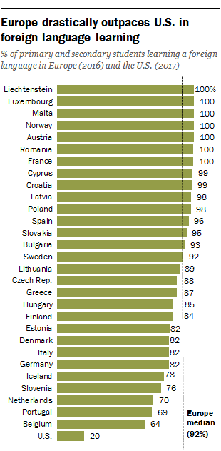
U.S. v European Union
In Europe, 92% of primary and secondary students are learning a foreign language.
In the united states it’s . . . 20%.
Most European countries have national-level mandates for formal language study. Students typically begin a first foreign language between 1st and 3rd grade.
Devlin, K. (2018). Most European students are learning a foreign language in school while Americans lag. FactTank: News in the Numbers. Pew Research Center. [www.pewresearch.org/fact-tank]

Slide 55
Colleges cut 651 foreign-language programs.
Higher education, in aggregate, lost just one such program from 2009 to 2013. From 2013 to 2016, it lost 651.
The net loss is a "stunning statistic" that may illustrate how extensively colleges designated foreign-language programs for cuts. "I don't want to call it a trend yet," said Dennis Looney, who directs the MLA’s Association of Departments of Foreign Languages. But "everything has really accelerated."
Johnson, S. (2019). Colleges lose a ‘stunning’ 651 foreign language programs in 3 years. The Chronicle of Higher Education. [www.chronicle.com]

Slide 56
Only 10 states and the District of Columbia make foreign-language learning a high school graduation requirement.
The decline in language education could have devastating effects for generations to come. With fewer options for learning a foreign language in school, a sharp decrease in interest is likely to follow.
Engle, J. (2019). How important is knowing a foreign language? The New York Times. [www.nytimes.com]

Slide 57
Meanwhile. . .
Foreign language learning apps like Rosetta Stone, Babbel and Duolingo have steadily gained popularity during the same time.
While Duolingo has amassed a base of almost 30 million monthly users according to its reported figures, its competitor Rosetta Stone expects to add more than 100,000 subscribers in 2019, a 24% increase from the previous year, according to its 2019 second-quarter earnings report.
Farrell, R. (2019). Foreign language courses experience decline in enrollment. The Union: El Camino College. [www. Eccunion.com]

Slide 58

Drake University, 2001
Drake University did what to many language professors was nothing less than horrific: It announced that foreign language instruction wasn't working, killed its language departments, and got rid of the instructors, including those with tenure.
Now, most language learning is taking place in small student groups of four -- coached not by a professor, but by a native speaker of the language, typically an international student. Many view this as a cop-out and a dangerous sidelining of professors.
Jaschik, S. (2007). Languages without faculty. Inside Higher Ed. [www.insidehighered.com]

Slide 59
The number of students earning a degree in languages has been shrinking.
Bachelor’s degrees conferred by postsecondary institutions, by field of study. Digest of Education Statistics. National Center for Educational Statistics. [www.nces.ed.gov]

Slide 60
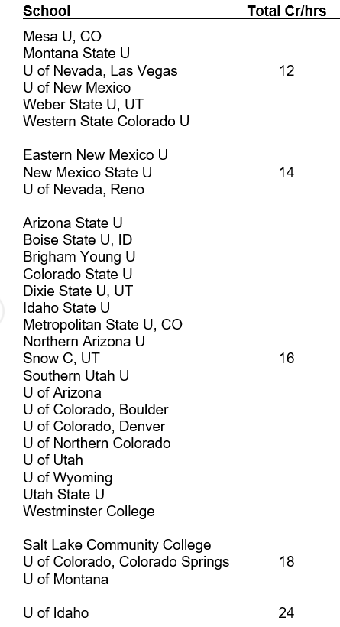
The number of credits required for the B.A. has been shrinking.

Slide 61
The number of credits required for the B.A. has been shrinking.

Slide 62
Online and Hybrid Instruction is becoming more common in lower division courses.
Time will tell whether this is a plus or a minus on the way to proficiency.

Slide 63

The future. . . .
So, will the pendulum swing back toward grammar translation and away from proficiency?
There are signs that it is well on it’s way.
A bright spot, Utah seems to have a model that could show how proficiency can be achieved:
start when students are young
keep instruction content based
keep students working though elementary school, middle school, high school and the university
allow several pathways for students, heritage speakers, returned missionaries, foreigners, etc. to participate.

Slide 64
Gracias.
FIN

